Slide 1
Demystifying Computing with Python
The class will start soon…

Slide 2
dcwp-3-d+e
BDDM:Demystifying Computing
with
Python
makers = {“concept”:”ss, “coding”:”da”, “revision”:”ap”,, “assistance”:”am”}

Slide 3
What we will learn today?
Lecture outcomes:
Multidimensional lists (arrays)
Learn the use of dictionaries (vs. lists)
Algorithms:
Binary search
Lab outcomes:
Using arrays
Using dictionaries

Slide 4

Debugging
The process of identifying and removing errors from computer hardware or software.
"software debugging”
Prevent bugs by identifying corner cases
The user will input two numbers
The program will print the division of the first number over the second number
What could go wrong?

Slide 5

Let's start with a few quizzes!
Debug (fix) the following code samples
print("Hi there, I am learning Python and I like it!)

Slide 6
Let's start with a few quizzes!
Debug (fix) the following code samples
name = "Stelios"
age = 37
print("My name is " + name + " and I am " + age + " years old. " )
Syntax error: it doesn’t print!
Semantics error: Stelios is not 37 anymore!

Slide 7
Let's start with a few quizzes!
Debug (fix) the following code samples
quantity = input("Enter quantity: ”)
cost = 2
print("Cost is: ", quantity * cost)

Slide 8
Solutions
Quiz 1
print("Hi there, I am learning Python and I like it!”)
Quiz 2
name = "Stelios"
age = 37
print("My name is " + name + " and I am " + str(age) + " years old. ”)
Quiz 3
quantity = int(input("Enter quantity: "))
cost = 2
print("Cost is: ", quantity * cost)

Slide 9
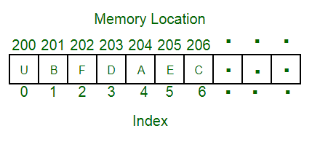
Data structures
“A data organization, management, and storage format that enables efficient access and modification”
Lists are the most common Python data structure.
They generalise the concept of array: a sequence of homogeneous values (e.g., all characters, all integers …)

Slide 10
Data structures: sequences
Python strings and lists are sequences, i.e., elements are indexed and we use the “[i]” notation to access a single element directly or a for cycle to access all single element iteratively.

Slide 11
1xD array vs 2xD array
0
1
2
3
4
5
10
20
30
40
50
60
Single row of elements
col 0
col 1
col 2
col 3
col 4
col 5
row 0
10
20
30
40
50
60
row 1
11
21
31
41
51
61
Multi row of elements
row 2
12
22
32
42
52
62

Slide 12
Multidimensional arrays
Mixed (text and numbers) data sets are often organized as 2-dimensional arrays.
Example:
my_writers =[
[”Dickens", 1812],
[”King", 1947],
[”J.K. Rowling", 1965],
[”Christie", 1890]
]
for row in my_writers:
print(row)
# Will print:
Dickens | 1812
King | 1947
J.K. Rowling | 1965
Christie | 1890
[”Dickens", 1812],
[”King", 1947],
[”J.K. Rowling", 1965],
[”Christie", 1890]

Slide 13
Extracting elements from 2D list
We use two for loops!
For loop for each row in the data
For loop for each element in the row
Dickens
1812
King
1947
J.K. Rowling
1965
Christie
1890
my_writers = [
[”Dickens", 1812],
[”King", 1947],
[”J.K. Rowling", 1965],
[”Christie", 1890]
]
for row in my_writers :
for element in row:
print(element)

Slide 14


Data structures: Arrays vs. Dictionaries
An array is a ‘linear’ collection of homogeneous values (most of the times), order is relevant.
A dictionary is a ‘bag’ of values, each with its own label.

Slide 15
Dictionaries
A dictionary is a collection which is unordered, changeable and indexed.
Python dictionaries are denoted by curly brackets, and consist of key:value pairs.
Dictionaries are Python’s most powerful data structure
my_data = { “author”: “Agatha Christie”, “nickname”: “Mary Westmacott”, “year_of_birth”: 1890 }

Slide 16
Dictionaries: Accessing items
print(my_data[“author”])
# will print…
Agatha Christie
my_data = { ”author": ” Agatha Christie ", ”nickname": " Mary Westmacott ", "year_of_birth": 1890 }
year = my_data[“year_of_birth”]
print(year)
# will print…
1890

Slide 17
Changing values in items
UPDATE THE VALUE
my_data[“year_of_birth”] = 2019
year = my_data[“year_of_birth”]
print(year)
# OR
print(my_data[“year_of_birth”])
# will print…
2019
my_data = { ”author": ” Agatha Christie ", ”nickname": " Mary Westmacott ", "year_of_birth": 1890 }

Slide 18
Iterating over a dictionary
for key, value in my_data.items():
print(key, value)
# This will print
author Agatha Christie
nickname Mary Westmacott
year_of_birth 1890
my_data = { ”author": ” Agatha Christie ", ”nickname": " Mary Westmacott ", "year_of_birth": 1890 }

Slide 19
Iterating over a dictionary, 2
for key in my_data.items():
print(key)
# This will print
author
nickname
year_of_birth
my_data = { ”author": ” Agatha Christie ", ”nickname": " Mary Westmacott ", "year_of_birth": 1890 }

Slide 20
Iterating over a dictionary, 3
For value in my_data.items():
print(value)
# This will print
Agatha Christie
Mary Westmacott
1890
my_data = { ”author": ” Agatha Christie ", ”nickname": " Mary Westmacott ", "year_of_birth": 1890 }

Slide 21
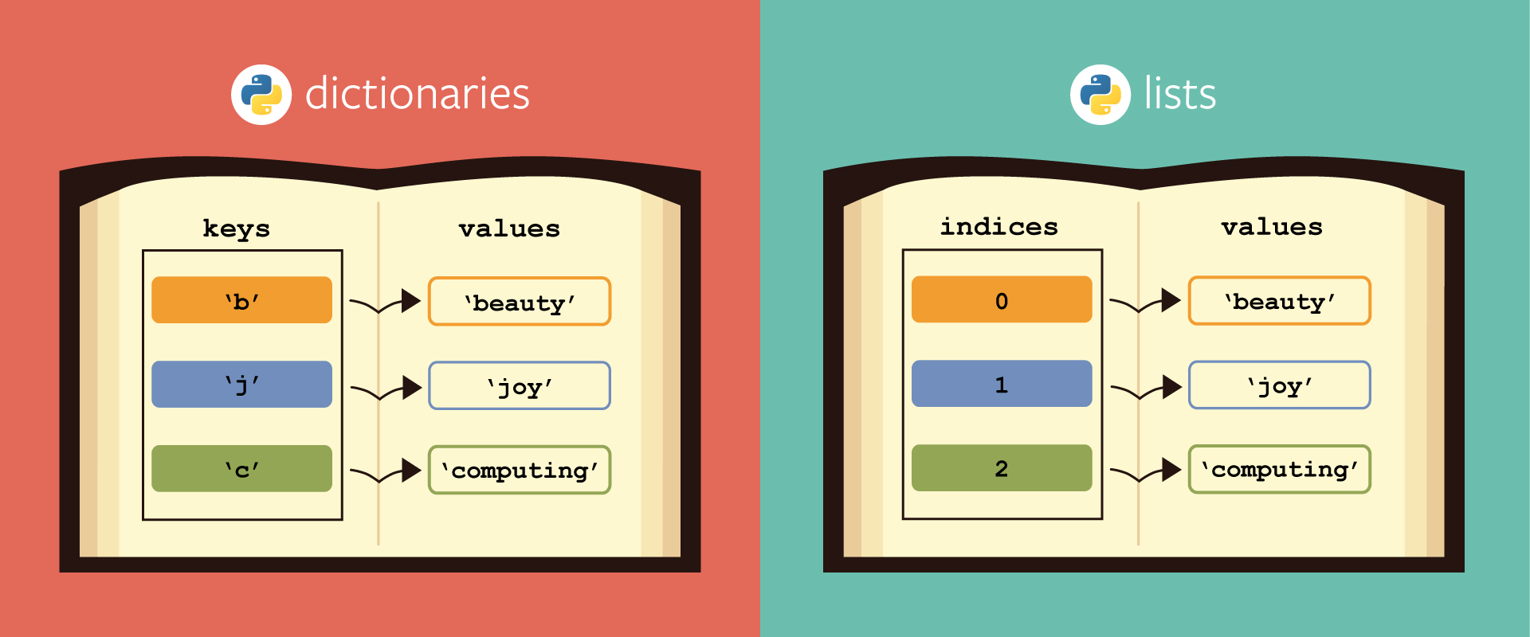
Lists vs. Dictionaries

Slide 22
Lists vs. Dictionaries
alist = []
alist.append(10)
alist.append(20)
print(alist)
# will print [10, 20]
alist[0]
# wil print 10
ad = {}
ad[“name”] = “Tom”
ad[“age”] = 30
print(ad)
# will print # {‘name’: Tom’, ‘age’:30}
print(ad[“name”])
# will print # Tom

Slide 23
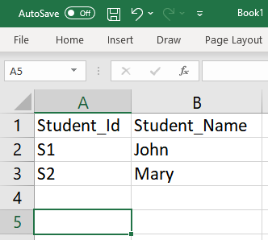
Dictionaries: One key, many values…
my_data = { "Student_ID": [ “S1",“S2" ], “Student_Name": [ “John",“Mary" ] }

Slide 24
Dictionaries: Common operations
#create an empty dictionary
x = {}
#create a three items dictionary
x = {"one":1, "two":2, "three":3}
#access an element
x["two"]
# mind errors by accessing non-existent keys!
#get a list of all the keys
x.keys()
#get a list of all the values
x.values()
#add an entry
x["four"]=4
#change an entry
x["one"] = "uno“
#number of items
z = len(x)
#looping over keys
for item in x.keys():
print item
#looping over values
for item in x.values():
print item

Slide 25
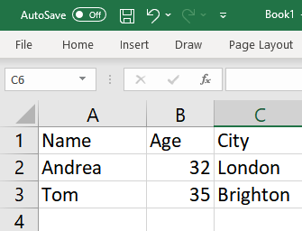
Quiz!
Create a dictionary out of the following dataset:

Slide 26
Quiz solution!
Create a dictionary out of the following dataset:
my_data = { "Name": [ "Andrea","Tom" ], "Age": [ 32,35 ], "year": [ "London","Brighton" ] }

Slide 27
E-bis: back to algorithms
Dealing with numbers is easy but time-consuming, esp. comparing values from a large collection.
In CS we “count the beans” to estimate the computational time and memory allocation needed to carry out a task before even starting, in search of possible savings.

Slide 28
Back to algorithms
Each comparison is an operation
We care about the worst case scenario…
In worst case, how many operations to find a number?
As many as the length of the list…

Slide 29
Algorithms for searching
Searching is a common problem to solve
We discussed “Linear search”
Looking for an element in a list, by comparing key with each value.
If I have n items in my list, then worst case scenario is to make n comparisons
alist = [4, 9, 12, 16, 18], looking for key=6
In principle, there are n comparisons, thus n operations, where n, in our case is 5 as many as the items!

Slide 30
Algorithms for searching cont.
Using the same list:
alist = [4, 9, 12, 16, 18], looking for key=9
What is n in our case?
In principle, there are n comparisons, thus n operations, where n, in our case is 5 as many as the items!

Slide 31
Another way to search
We have an ordered list
alist = [10, 20, 30, 40, 50, 60, 70, 80, 90, 100]
We are looking for an element e.g. 80.
Is there a way to search more efficient?
Efficiency: Reduce the number of operations!

Slide 32
Binary search

Slide 33
Binary search
Each comparison will halve the size of the input data to check
Compare the given search key with the middle element.
If key matches with middle element, we return its index (mid)
Else if key is greater than the mid element, then key can only lie in the right/upper half of the list, i.e., after the mid element. So we recur on the right/upper half of the list.
Else (key is smaller) recur on the left/lower half of the list.

Slide 34
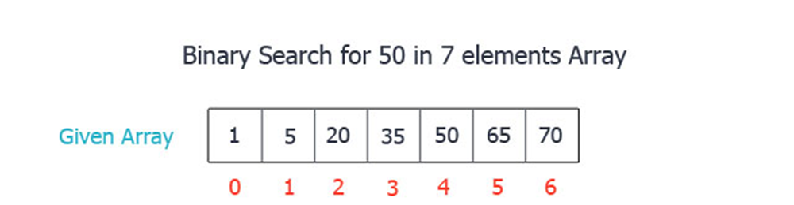

A simple example

Slide 35
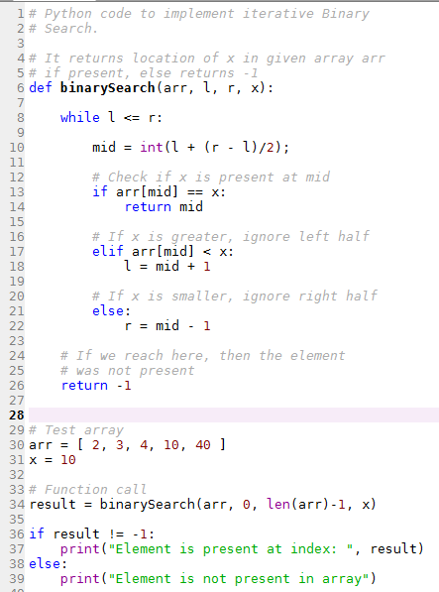
Lets understand the code!
While left index is lower or equal to the right index (i.e., there’s still some data to look at)
If the element at this index is the key
We found it!
Else if the value is less than the key
Ignore the left half
Else ignore the right half
Always update the pointers to the left or right index

Slide 36
Quiz!
Let us assume we have a list of letters from A to X
How many operations will need a linear search to find letter ‘J’?
How many using a binary search?

Slide 37
Quiz Solution!
Let us assume we have a list of letters from A to X
How many operations will need a linear search and a binary search to find letter ‘J’?
Linear search: 10
Binary search: 4

Slide 38
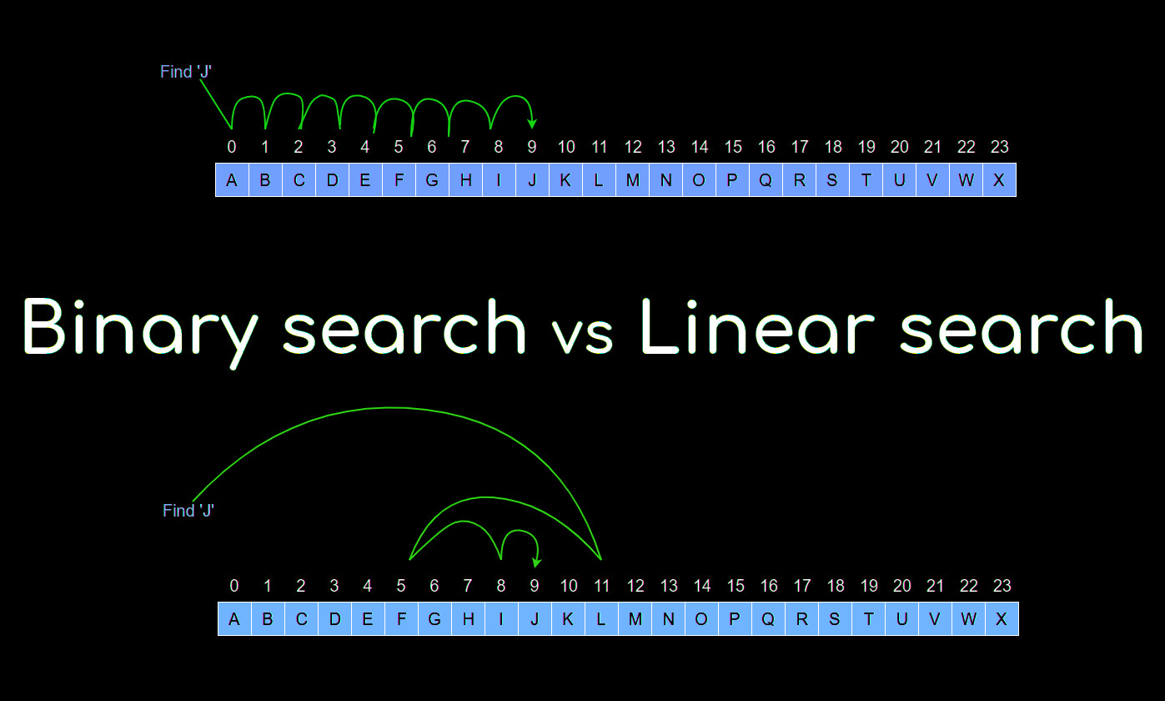

Slide 39
Recap
my_writers = [
[”Dickens", 1812],
[”King", 1947],
[”J.K. Rowling", 1965],
[”Christie", 1890]
]
for row in my_writers:
print(row)
# Will print:
Dictionary
Data structure to store key:value pairs
Flexible yet requires careful preliminar study of the data
Keys must be unique!
The Search problem: checking membership to a list.
Linear and Binary search
[”Dickens", 1812],
[”King", 1947],
[”J.K. Rowling", 1965],
[”Christie", 1890]

Slide 40
Lab 3-f Programming with Python
Demystifying Computing with Python

Slide 41
Lab session
Download the questions in your local machine:
dcwp-4-f-questions.ipynb
Either work locally with VS Code or upload the notebook to your Google Colab (see next slide for how to upload it)

Slide 43
Thank you!
Personal study:
Read this hands-on introduction to Text Mining: https://datawookie.dev/blog/2013/09/text-mining-the-complete-works-of-william-shakespeare/

